Slide 1
Air Force Survey Analysis
(Sanitized Results)
Names of USAF units, service member unit identification, and descriptions of source data were changed or removed to preserve privacy.
1

Slide 2
Survey Analysis Outline
Introduction
Processing Steps
Exploratory Factor Analysis
Cluster Analysis
Analysis Results

Slide 3
Introduction
United States Air Force (USAF) collected survey data from 2013-2021 in order to identify overall trends in organizational climate.
Service members answered a variety of questions related to their opinions on training, resources, morale, and leadership.
Questions changed over time, and servicemen were not required to answer all of the questions leading to a sparsity of responses
Our Objective: Contextualize morale findings with key themes found in the survey data
3
3

Slide 4
Processing Steps
Methodology:
Filtered Respondents and Survey Questions (see sidebar on right)
Mapped Survey Question responses to numbers
After filtering, there were 62 unique but highly correlated (and somewhat sparse) survey responses.
This type of data requires further data reduction through the use of an Exploratory Factor Analysis (EFA) before trends can be identified in a cluster analysis.
Original Survey Responses
9,804 respondents
147 Survey questions
Strongly Disagree | Disagree | Missing/ Unsure | Agree | Strongly Agree
-2 | -1 | 0 | 1 | 2
Respondents answered >50% of questions
Question answered >50% of the time
For Analysis
7,867 Respondents
62 questions
4
Notes:
Objectives
Responses to Survey Questions were coded on a -2 to +2 scale, with 0 representing missing or ‘unsure’ responses.
Identify and summarize key themes in responses to the Survey questions
Tie themes to descriptive demographic variables (rank, location, job role, time period, etc.) to contextualize morale findings
Because the Survey data was so rich, the analysis team thought it would be beneficial to find any themes and groups of respondents who answered the questions similarly in order to add more context to morale findings. The Survey data touches on many topics known to contribute to morale (recall: Organizational Climate)
Cluster Analysis was used to summarize the factors identified in EFA to categorize each respondent into unique groups (“clusters”) of respondents
Thus, if a unit or wing is flagged for low morale,
Data
Respndent data from 10,815 unique respondents and 154 Survey questions from 2013 through 2021. The following elements were excluded
Respondents who were not military members (-7 questions and -1,963 respondents)
Survey Questions whose responses were not streamlined were excluded (-17 questions)
Respondents who did not answer more than 50% of the questions were excluded (- 295 respondents)
Survey Questions that were not answered more than 50% of the time were excluded (-68 questions)
Leaving 62 Survey questions from 8,552 unique respondents which were included in this analysis
Responses to Survey Questions were coded on a -2 to +2 scale, with 0 representing missing or ‘unsure’ responses.
Each Survey question was phrased in a positive sense leading to a high percentage of agreement between questions.

Slide 5
Exploratory Factor Analysis: Methodology
Exploratory Factor Analysis (EFA) is a variable reduction technique which identifies and aggregates underlying patterns from a larger set of correlated variables into groups of common patterns of responses
Once identified, these underlying patterns, called factors, can reduce the questions into a smaller set of variables by topic
In this case, EFA grouped related Survey questions into 9 common factors which we tagged as:
Leadership
Strategic Plan
Additional Duties
Equipment
Duty Schedule
Supervisor
Adequate Training
Sufficient Personnel
Sexual Harassment /Suicide
Survey Questions
?
?
?
?
?
?
?
?
Factors
?
?
?
?
?
?
F₁
F₂
...
F_{n}
?
?
?
?
?
?
?
?
?
?
?
5

Slide 6
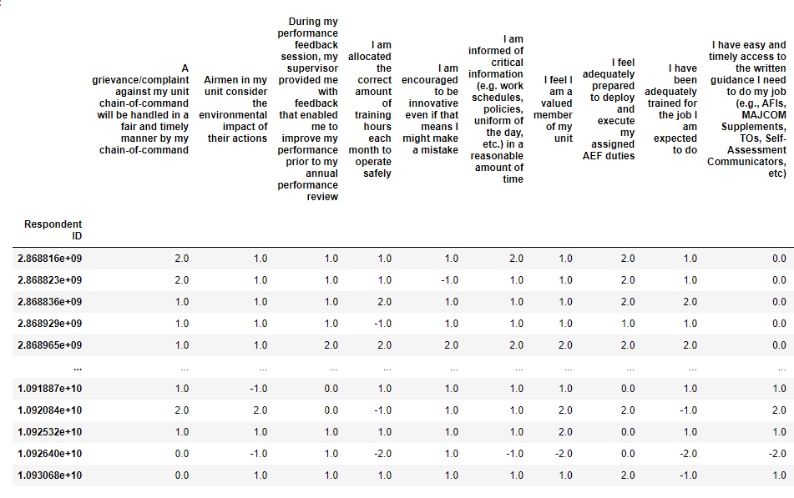
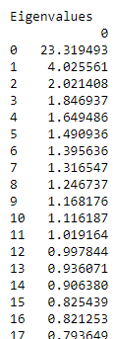
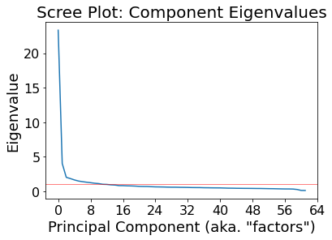
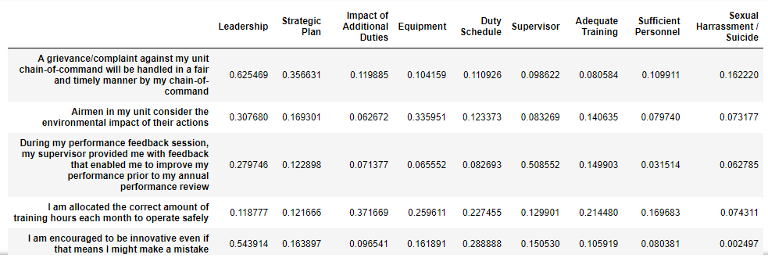
Exploratory Factor Analysis: Steps in Detail
Numeric Survey Responses
Factor Eigenvalues
Linear dimensionality reduction techniques are used on the Survey responses to calculate their eigenvalues* for each factor (also generates their loadings** for each question with respect to each factor)
High eigenvalues indicate factors that explain the underlying response patterns
Optimal Number of Factors = 9
The eigenvalues are used to determine the optimal number of factors (as visualized by the Scree Plot on the right)
The top 9 factors cover 73% of the explainable variation in the data
Factor loading scores for each Survey question
The loadings are used to identify only the essential questions for each of the 9 factors
Each factor has a few essential questions associated with it
*the amount of variance explained by each factor
**coefficients that tell us how strong the relationship is between a Survey question and its factor. Loadings greater than 0.5 are considered essential.
6

Slide 7
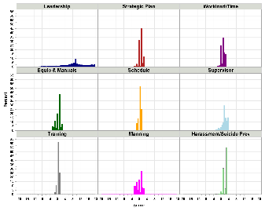
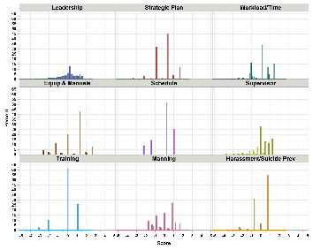
Cluster Analysis: Methodology
Goal: Use cluster analysis to identify distinct groups (“clusters”) of respondents who responded to the surveys similarly in order to add context to differences in morale
The factors derived from the EFA data reduction technique form the basis of the Clustering Analysis
Respondent’s factor scores are standardized for each of the 9 factors
Standardized Respondent Scores
Standardized
(mean = 0; st dev. = 1)
Cluster Model (Gaussian Mixture) determines 5 distinct clusters of respondents
Five Distinct Clusters
Gaussian Mixture to Identify distinct clusters
Identify unique characteristics for each cluster
Document observed patterns of factors, morale and additional context variables
Recommendations…
……………………….
………………………………………………………………………………………………………………………...
Analysis
** | ** | ** | **
** | ** | ** | **
** | ** | ** | **
** | ** | ** | **
** | ** | ** | **
7
Notes:
Clusters were analyzed based on the 9 factors alone (morale-agnostic). Morale was only assessed after the fact by assessing the other characteristics of each cluster.

Slide 8
Cluster Analysis: Results
Cluster Analysis on the UEI data revealed 5 distinct clusters with unique characteristics, defined by the cluster average factor scores detailed below
Clusters are sorted by average Group Morale (highest to lowest)
Values are standardized, so a value of +1.0 or -1.0 is a standard deviation away from the population mean
Green and red highlights indicate the highest and lowest average scores for each factor
By studying the differences in the scores between clusters as well as cluster demographics, cluster ‘profiles’ can be revealed
Factors
Descriptive
Features
Cluster | Leadership | Strategic Plan | Additional Duties | Equipment | Duty Schedule | Supervisor | Adequate Training | Sufficient Personnel | Sexual Harassment /Suicide
1 | 0.46 | 0.34 | 0.07 | 0.31 | 0.13 | 0.36 | 0.28 | 0.08 | 0.75
2 | -0.08 | -0.05 | 0.11 | -0.13 | 0.31 | -0.09 | 0.03 | 0.11 | -0.28
3 | -0.39 | -0.28 | -0.23 | -0.22 | -0.97 | -0.25 | 0.33 | -0.19 | -0.6
4 | -0.84 | -0.69 | -0.5 | -0.38 | -0.24 | -0.7 | -2.26 | -0.57 | -0.75
5 | -1.59 | -1.16 | -0.42 | -0.82 | -1.33 | -1.13 | -0.58 | -0.51 | -2.3
Group Morale | Cluster Size (%)
0.29 | 3337 (42%)
0.02 | 2958 (38%)
-0.4 | 729 (9%)
-0.59 | 455 (6%)
-1.2 | 388 (5%)
8
Notes:
Highest ranks have the highest group morale and score positive on every question.
The Lowest ranks have the least group morale and score negative on every question.
Then it gets interesting. Of the 2nd, 3rd, 4th, and 5th, clusters with the least group morale, their dissatisfaction can be traced to (largely) a single topic! Whether its lack in: Leadership Discipline Fairness, A Predictable Schedule, A Concerned Supervisor, or Adequate Training.
Shown below are the clusters identified using the Gaussian Mixture model to cluster the data using the previously identified 9 factors of Survey data, which has been standardized (scaled so that the population mean is 0). Rank, group morale (Y), and count per officer rank are included as descriptive columns. Data is sorted with the highest Group Morale values at the top. The green and red highlights identify the highest and lowest values of each respective column.
Five clusters resulted in the most stable and are displayed below.

Slide 9
Cluster Analysis: Results
Cluster 1 (42%): “High Group Morale” Cluster:
Largest cluster, higher ranked military members on average, comparatively favorable responses in all 9 factors.
Factors
Descriptive
Features
Cluster | Leadership | Strategic Plan | Additional Duties | Equipment | Duty Schedule | Supervisor | Adequate Training | Sufficient Personnel | Sexual Harassment /Suicide
1 | 0.46 | 0.34 | 0.07 | 0.31 | 0.13 | 0.36 | 0.28 | 0.08 | 0.75
2 | -0.08 | -0.05 | 0.11 | -0.13 | 0.31 | -0.09 | 0.03 | 0.11 | -0.28
3 | -0.39 | -0.28 | -0.23 | -0.22 | -0.97 | -0.25 | 0.33 | -0.19 | -0.6
4 | -0.84 | -0.69 | -0.5 | -0.38 | -0.24 | -0.7 | -2.26 | -0.57 | -0.75
5 | -1.59 | -1.16 | -0.42 | -0.82 | -1.33 | -1.13 | -0.58 | -0.51 | -2.3
Group Morale | Cluster Size (%)
0.29 | 3337 (42%)
0.02 | 2958 (38%)
-0.4 | 729 (9%)
-0.59 | 455 (6%)
-1.2 | 388 (5%)
Average factor scores and mean group morale were standardized so that the population mean is 0.
A factor score of 1 means that cluster’s average score for that factor is one standard deviation above the population mean.
9
Notes:
Highest ranks have the highest group morale and score positive on every question.
The Lowest ranks have the least group morale and score negative on every question.
Then it gets interesting. Of the 2nd, 3rd, 4th, and 5th, clusters with the least group morale, their dissatisfaction can be traced to (largely) a single topic! Whether its lack in: Leadership Discipline Fairness, A Predictable Schedule, A Concerned Supervisor, or Adequate Training.
Shown below are the clusters identified using the Gaussian Mixture model to cluster the data using the previously identified 9 factors of Survey data, which has been standardized (scaled so that the population mean is 0). Rank, group morale (Y), and count per officer rank are included as descriptive columns. Data is sorted with the highest Group Morale values at the top. The green and red highlights identify the highest and lowest values of each respective column.
Five clusters resulted in the most stable and are displayed below.

Slide 10
Cluster Analysis: Results
Cluster 2 (38%): “Content with Schedule” Cluster: Second largest cluster with largely average responses; notably content with their workload and schedule predictability.
Factors
Descriptive
Features
Cluster | Leadership | Strategic Plan | Additional Duties | Equipment | Duty Schedule | Supervisor | Adequate Training | Sufficient Personnel | Sexual Harassment /Suicide
1 | 0.46 | 0.34 | 0.07 | 0.31 | 0.13 | 0.36 | 0.28 | 0.08 | 0.75
2 | -0.08 | -0.05 | 0.11 | -0.13 | 0.31 | -0.09 | 0.03 | 0.11 | -0.28
3 | -0.39 | -0.28 | -0.23 | -0.22 | -0.97 | -0.25 | 0.33 | -0.19 | -0.6
4 | -0.84 | -0.69 | -0.5 | -0.38 | -0.24 | -0.7 | -2.26 | -0.57 | -0.75
5 | -1.59 | -1.16 | -0.42 | -0.82 | -1.33 | -1.13 | -0.58 | -0.51 | -2.3
Group Morale | Cluster Size (%)
0.29 | 3337 (42%)
0.02 | 2958 (38%)
-0.4 | 729 (9%)
-0.59 | 455 (6%)
-1.2 | 388 (5%)
Average factor scores and mean group morale were standardized so that the population mean is 0.
A factor score of 1 means that cluster’s average score for that factor is one standard deviation above the population mean.
10
Notes:
Highest ranks have the highest group morale and score positive on every question.
The Lowest ranks have the least group morale and score negative on every question.
Then it gets interesting. Of the 2nd, 3rd, 4th, and 5th, clusters with the least group morale, their dissatisfaction can be traced to (largely) a single topic! Whether its lack in: Leadership Discipline Fairness, A Predictable Schedule, A Concerned Supervisor, or Adequate Training.
Shown below are the clusters identified using the Gaussian Mixture model to cluster the data using the previously identified 9 factors of Survey data, which has been standardized (scaled so that the population mean is 0). Rank, group morale (Y), and count per officer rank are included as descriptive columns. Data is sorted with the highest Group Morale values at the top. The green and red highlights identify the highest and lowest values of each respective column.
Five clusters resulted in the most stable and are displayed below.

Slide 11
Cluster Analysis: Results
Cluster 3 (9%): “Adequately Trained” Cluster: Slightly negative scores across most factors except “feeling adequately trained for jobs”, where they had the highest average score and a low score for schedule predictability.
Factors
Descriptive
Features
Cluster | Leadership | Strategic Plan | Additional Duties | Equipment | Duty Schedule | Supervisor | Adequate Training | Sufficient Personnel | Sexual Harassment /Suicide
1 | 0.46 | 0.34 | 0.07 | 0.31 | 0.13 | 0.36 | 0.28 | 0.08 | 0.75
2 | -0.08 | -0.05 | 0.11 | -0.13 | 0.31 | -0.09 | 0.03 | 0.11 | -0.28
3 | -0.39 | -0.28 | -0.23 | -0.22 | -0.97 | -0.25 | 0.33 | -0.19 | -0.6
4 | -0.84 | -0.69 | -0.5 | -0.38 | -0.24 | -0.7 | -2.26 | -0.57 | -0.75
5 | -1.59 | -1.16 | -0.42 | -0.82 | -1.33 | -1.13 | -0.58 | -0.51 | -2.3
Group Morale | Cluster Size (%)
0.29 | 3337 (42%)
0.02 | 2958 (38%)
-0.4 | 729 (9%)
-0.59 | 455 (6%)
-1.2 | 388 (5%)
Average factor scores and mean group morale were standardized so that the population mean is 0.
A factor score of 1 means that cluster’s average score for that factor is one standard deviation above the population mean.
11
Notes:
Highest ranks have the highest group morale and score positive on every question.
The Lowest ranks have the least group morale and score negative on every question.
Then it gets interesting. Of the 2nd, 3rd, 4th, and 5th, clusters with the least group morale, their dissatisfaction can be traced to (largely) a single topic! Whether its lack in: Leadership Discipline Fairness, A Predictable Schedule, A Concerned Supervisor, or Adequate Training.
Shown below are the clusters identified using the Gaussian Mixture model to cluster the data using the previously identified 9 factors of Survey data, which has been standardized (scaled so that the population mean is 0). Rank, group morale (Y), and count per officer rank are included as descriptive columns. Data is sorted with the highest Group Morale values at the top. The green and red highlights identify the highest and lowest values of each respective column.
Five clusters resulted in the most stable and are displayed below.

Slide 12
Cluster Analysis: Results
Cluster 4 (6%): “Undermanned & Inadequately Trained” Cluster: This cluster had the lowest scores for manning, training and having adequate time to complete daily workload.
Factors
Descriptive
Features
Cluster | Leadership | Strategic Plan | Additional Duties | Equipment | Duty Schedule | Supervisor | Adequate Training | Sufficient Personnel | Sexual Harassment /Suicide
1 | 0.46 | 0.34 | 0.07 | 0.31 | 0.13 | 0.36 | 0.28 | 0.08 | 0.75
2 | -0.08 | -0.05 | 0.11 | -0.13 | 0.31 | -0.09 | 0.03 | 0.11 | -0.28
3 | -0.39 | -0.28 | -0.23 | -0.22 | -0.97 | -0.25 | 0.33 | -0.19 | -0.6
4 | -0.84 | -0.69 | -0.5 | -0.38 | -0.24 | -0.7 | -2.26 | -0.57 | -0.75
5 | -1.59 | -1.16 | -0.42 | -0.82 | -1.33 | -1.13 | -0.58 | -0.51 | -2.3
Group Morale | Cluster Size (%)
0.29 | 3337 (42%)
0.02 | 2958 (38%)
-0.4 | 729 (9%)
-0.59 | 455 (6%)
-1.2 | 388 (5%)
Average factor scores and mean group morale were standardized so that the population mean is 0.
A factor score of 1 means that cluster’s average score for that factor is one standard deviation above the population mean.
12
Notes:
Highest ranks have the highest group morale and score positive on every question.
The Lowest ranks have the least group morale and score negative on every question.
Then it gets interesting. Of the 2nd, 3rd, 4th, and 5th, clusters with the least group morale, their dissatisfaction can be traced to (largely) a single topic! Whether its lack in: Leadership Discipline Fairness, A Predictable Schedule, A Concerned Supervisor, or Adequate Training.
Shown below are the clusters identified using the Gaussian Mixture model to cluster the data using the previously identified 9 factors of Survey data, which has been standardized (scaled so that the population mean is 0). Rank, group morale (Y), and count per officer rank are included as descriptive columns. Data is sorted with the highest Group Morale values at the top. The green and red highlights identify the highest and lowest values of each respective column.
Five clusters resulted in the most stable and are displayed below.

Slide 13
Cluster Analysis: Results
Cluster 5 (5%): “Low Morale” Cluster:
Smallest cluster with disproportionately high rates of Security and E4-E6 ranks. Comparatively unfavorable responses in every factor, but particularly unhappy with “Sexual Harassment / Suicide” and “Leadership” factors
Factors
Descriptive
Features
Cluster | Leadership | Strategic Plan | Additional Duties | Equipment | Duty Schedule | Supervisor | Adequate Training | Sufficient Personnel | Sexual Harassment /Suicide
1 | 0.46 | 0.34 | 0.07 | 0.31 | 0.13 | 0.36 | 0.28 | 0.08 | 0.75
2 | -0.08 | -0.05 | 0.11 | -0.13 | 0.31 | -0.09 | 0.03 | 0.11 | -0.28
3 | -0.39 | -0.28 | -0.23 | -0.22 | -0.97 | -0.25 | 0.33 | -0.19 | -0.6
4 | -0.84 | -0.69 | -0.5 | -0.38 | -0.24 | -0.7 | -2.26 | -0.57 | -0.75
5 | -1.59 | -1.16 | -0.42 | -0.82 | -1.33 | -1.13 | -0.58 | -0.51 | -2.3
Group Morale | Cluster Size (%)
0.29 | 3337 (42%)
0.02 | 2958 (38%)
-0.4 | 729 (9%)
-0.59 | 455 (6%)
-1.2 | 388 (5%)
Average factor scores and mean group morale were standardized so that the population mean is 0.
A factor score of 1 means that cluster’s average score for that factor is one standard deviation above the population mean.
13
Notes:
Highest ranks have the highest group morale and score positive on every question.
The Lowest ranks have the least group morale and score negative on every question.
Then it gets interesting. Of the 2nd, 3rd, 4th, and 5th, clusters with the least group morale, their dissatisfaction can be traced to (largely) a single topic! Whether its lack in: Leadership Discipline Fairness, A Predictable Schedule, A Concerned Supervisor, or Adequate Training.
Shown below are the clusters identified using the Gaussian Mixture model to cluster the data using the previously identified 9 factors of Survey data, which has been standardized (scaled so that the population mean is 0). Rank, group morale (Y), and count per officer rank are included as descriptive columns. Data is sorted with the highest Group Morale values at the top. The green and red highlights identify the highest and lowest values of each respective column.
Five clusters resulted in the most stable and are displayed below.

Slide 14
Analysis Results
Most USAF service members have moderate to positive group morale.
Minor deviations due to identified concerns regarding training, scheduling, or staffing issues (clusters 2, 3, and 4 respectively).
Group Morale scores plummet in the smallest cluster that was the only cluster whose group morale scores were an entire standard deviation away from the mean.
We saw major concerns regarding suicide and sexual harassment with any service member associated with cluster 5.
14

